Slide 1


Python-Powered Financial Performance Analysis Engine & Dashboard
Alexander Moshchev | Cheng Yu | Jing Wang | Marius Gnoth |

Slide 2
Outline
Outline
Project Overview
01
Case Study: Coca-Cola vs. PepsiCo Business Model
02
Data Pipeline Overview & Implementation
03
Code and Dashboard Demonstration
04
Comparative Financial & Accounting In-Depth Analysis
05
Conclusion
06

Slide 3
Python-powered Financial Analysis engine & Dashboard
Project Overview
Pain Point:
Manual data retrieval from financial sources is time-consuming and prone to errors
Investors and analysts need for financial comparison
Primary Data Sources:
Income statement, balance sheet, cash flow statement
Solution:
Automated financial data retrieval & preprocessing
Calculation of relevant financial ratios over 4 year horizon
User-friendly interactive dashboard
Comparison feature
Financial ratios express relationships between financial statement items and make companies performances comparable.
Notes:
We wanted do so some financial performance analysis Liquidity, Solvency, Profitability and Selected Ratios: Efficiency Ratios

Slide 4
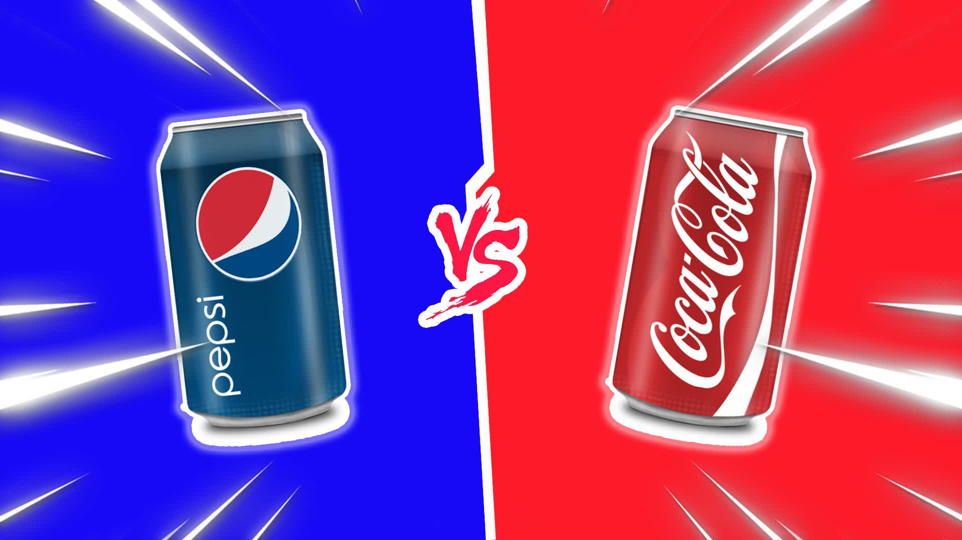
Notes:
500 pages 10-K vs. 100 pages 10-K

Slide 5
Business Model

Slide 6

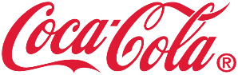
Background Analysis
Business Model
PepsiCo (PEP) and Coca-Cola (KO) dominate the beverage (and convenient goods) market
Which company do you think is larger by revenue? And by how much?
86.39 Billion USD
43.00 Billion USD
Brand Value: 18 Billion USD (> 500 Brands)
Brand Value: 33 Billion USD (> 200 Brands)
* Source: Revenue: Form 10-K
** Source: Brand Value: Statista
Notes:
https://www.statista.com/statistics/603922/brand-value-non-alcoholic-beverage-brands-worldwide/#:~:text=Brand%20value%20of%20the%20most%20valuable%20soft%20drink%20brands%20worldwide%202023&text=With%20a%20brand%20value%20of,around%2018%20billion%20U.S.%20dollars.

Slide 7
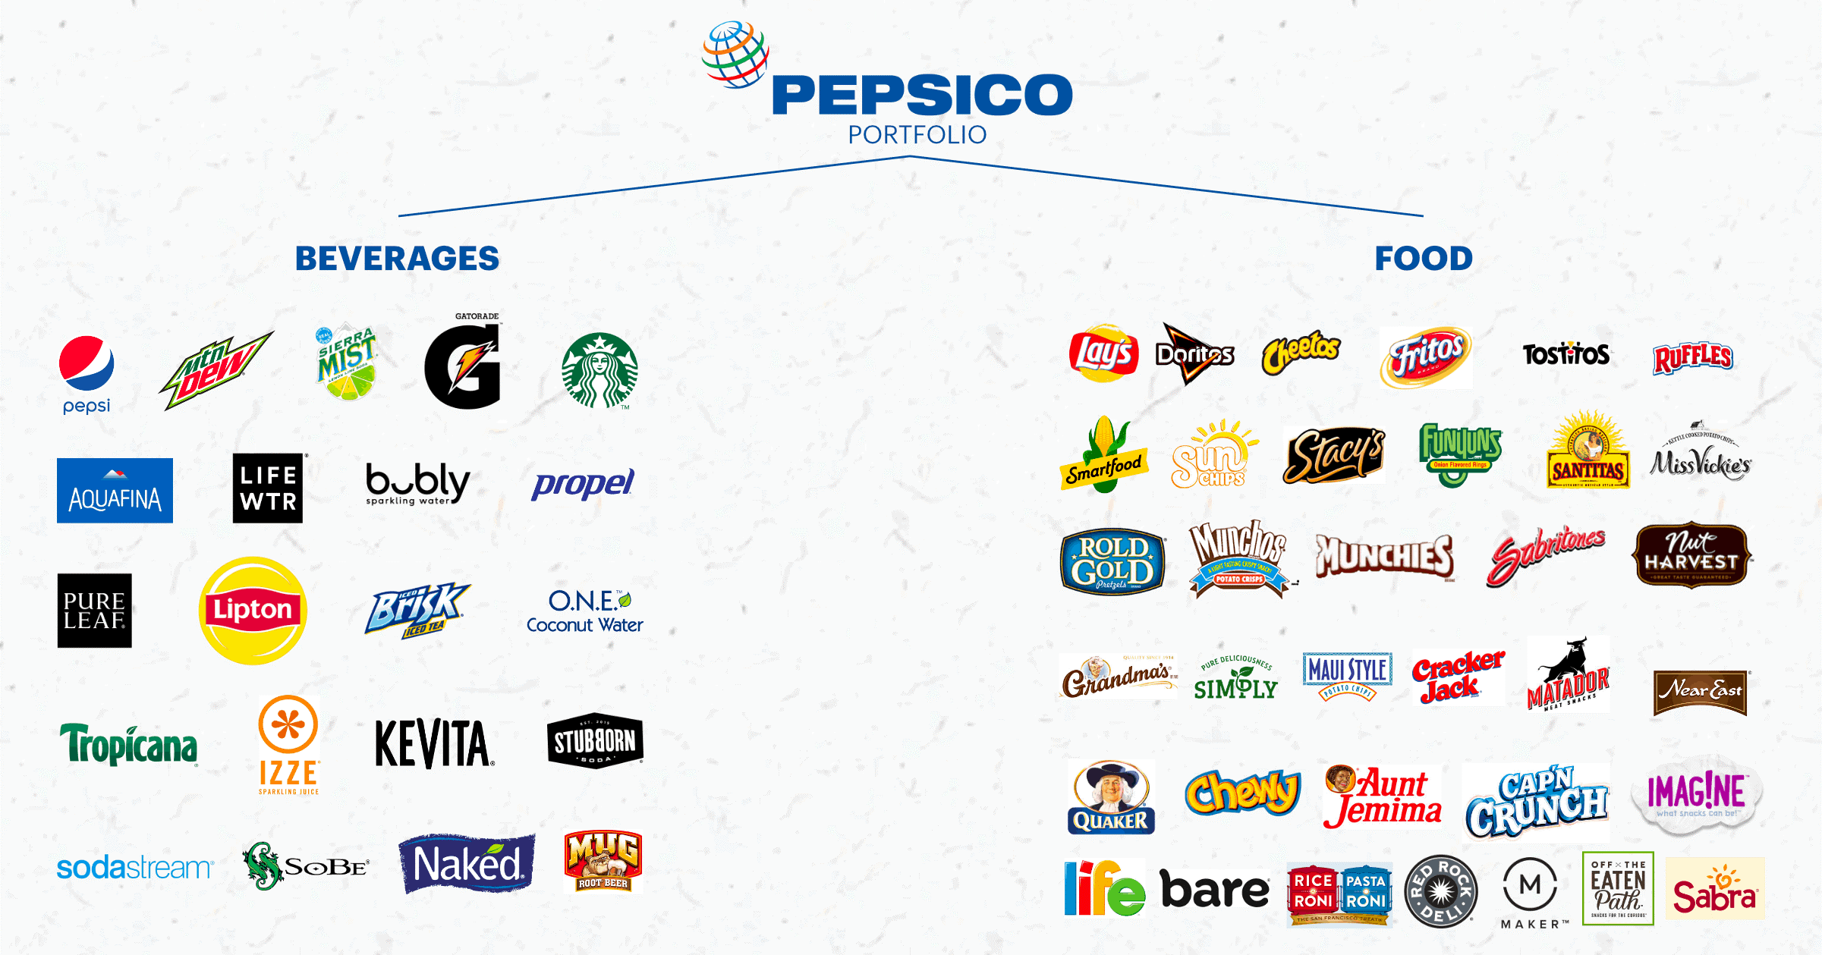
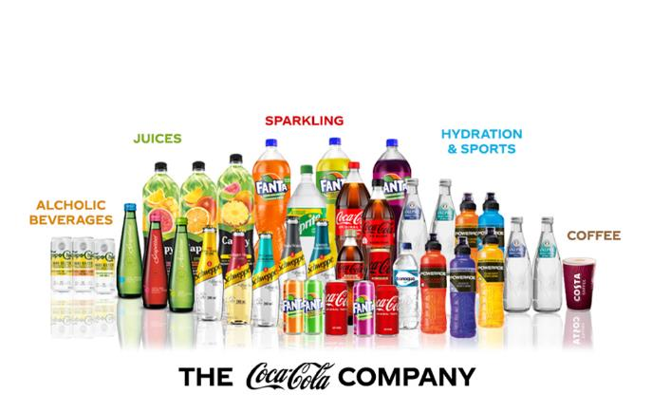
Comparison Brand & Product Portfolio
Business model
42 %
58 %
Diversification strategy similar to Nestlé. Convenient food focus in emerging markets.
Core flagship brand with variations.
Coca-Cola and PepsiCo remain their main rivals in the beverage industry, while PepsiCo underscores its resilience and adaptability in navigating a cross-industry competitive landscape.

Slide 8

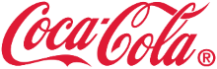
Market share Net Operating Revenue
Business model
Both companies exhibit a nearly equal geographic distribution of market share in terms of relevance, with North America standing out currently as the largest market. The emphasis and growth efforts are directed toward developing countries.
* Number not divided by operation segment and not issued by Pepsico 10-K
Source: 10-K

Slide 9
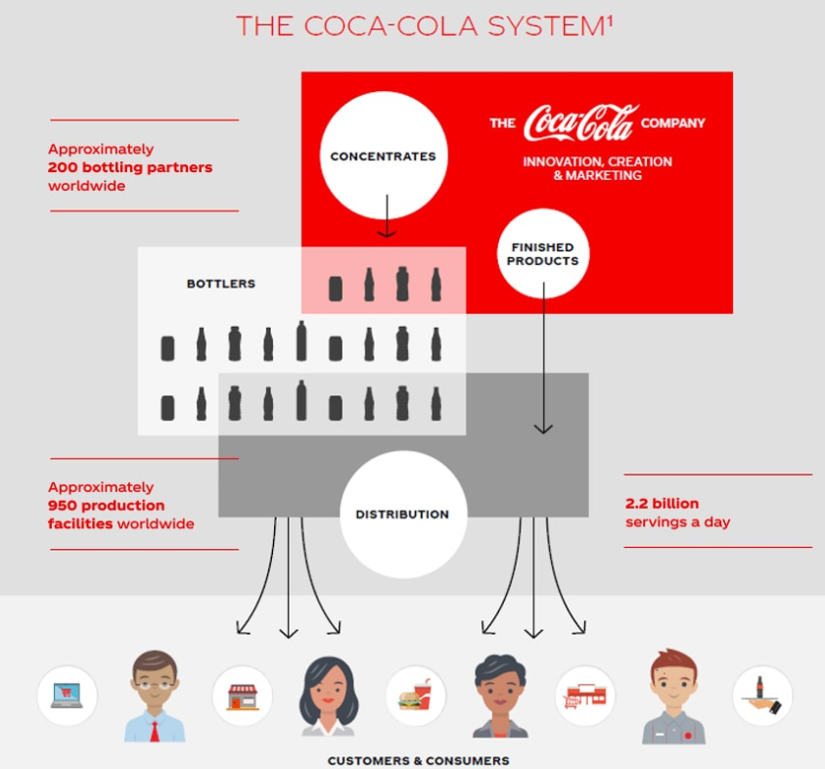
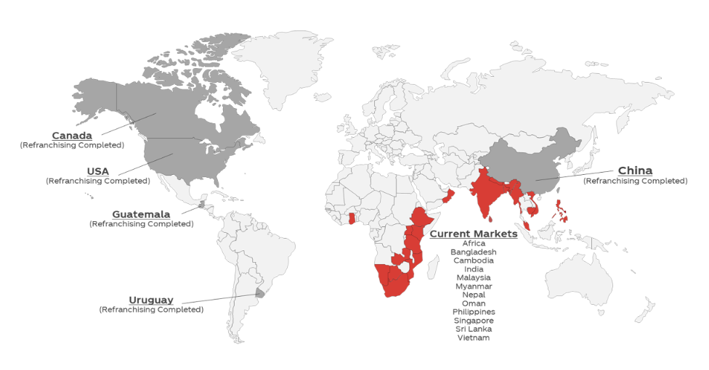
Business model: bottling partners
Business model
Growth concept: Re-Franchising
Acquisition of bottling operators, bottling plants and distribution centers in emerging markets (major stakes)
Build stable production, supply and distribution chain under ownership
Sell holdings but maintain franchisor agreements for syrups with bottling partners
Renewal of terms and conditions (large bargaing power)
Revenue Margin
Revenue Margin
Source: BIG

Slide 10
BUSiness Model Canvas
Business Model
Key Partners
Key Activities
Value Proposition
Customer Relations
Customer Segments
Bottlers & distribution partners
Developing, producing, marketing, selling of beverages, syrup (& convienient goods)
Worldwide diverse portfolio of beverages (& convienient foods)
Targeting consumer through omnipresent advertising
B2C: Supermarkets, convience stores, e-commerce
Pioneer of & adaption to market trends
Suppliers & retailers
Branding, trademarks and licence fees
Key Resources
Channels
B2B(2C): Retailer, Foodservice Providers, distributors
Bottling plants
Brands and intellectual property
Direct Store Delivery, Warehousing, Retail, distributor networks, e-commerce
Strategic alliances
Quality & taste
Inno-vation
Distribution network
Cost Structure
Revenue Streams
Marketing & advertising
Raw materials: agricultural producs, energy, metals
Shipping and handling activities
Sales of beverages (convience goods)
Licensing fees from bottling and distribution partners
M&A and investment income
10

Slide 11
Implementation

Slide 12









Overview: Data Pipeline of the MVP
Implementation
Company Ticker Entry
Formatting & Transformations
Calculation of Financial Ratios
Pre-processed Data
Raw Data
API Call
Visualization Dashboard
Balance Sheet
Income Statement
Cash Flow Statement
12

Slide 13
Dashboard DEMO & Ratio Analysis
Notes:
profitability, liquidity, solvency, and operational ability analysis,

Slide 14
Comparative Financial & Accounting Analysis
14

Slide 15
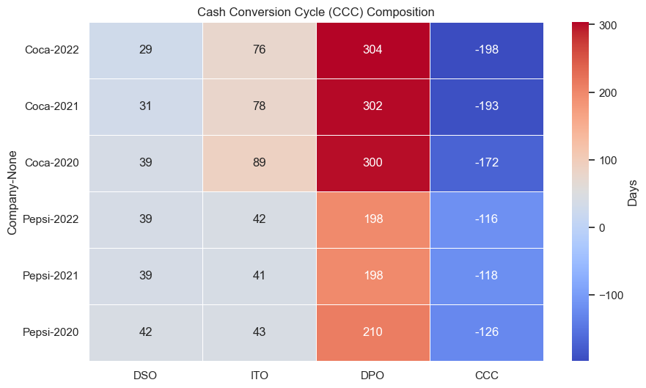
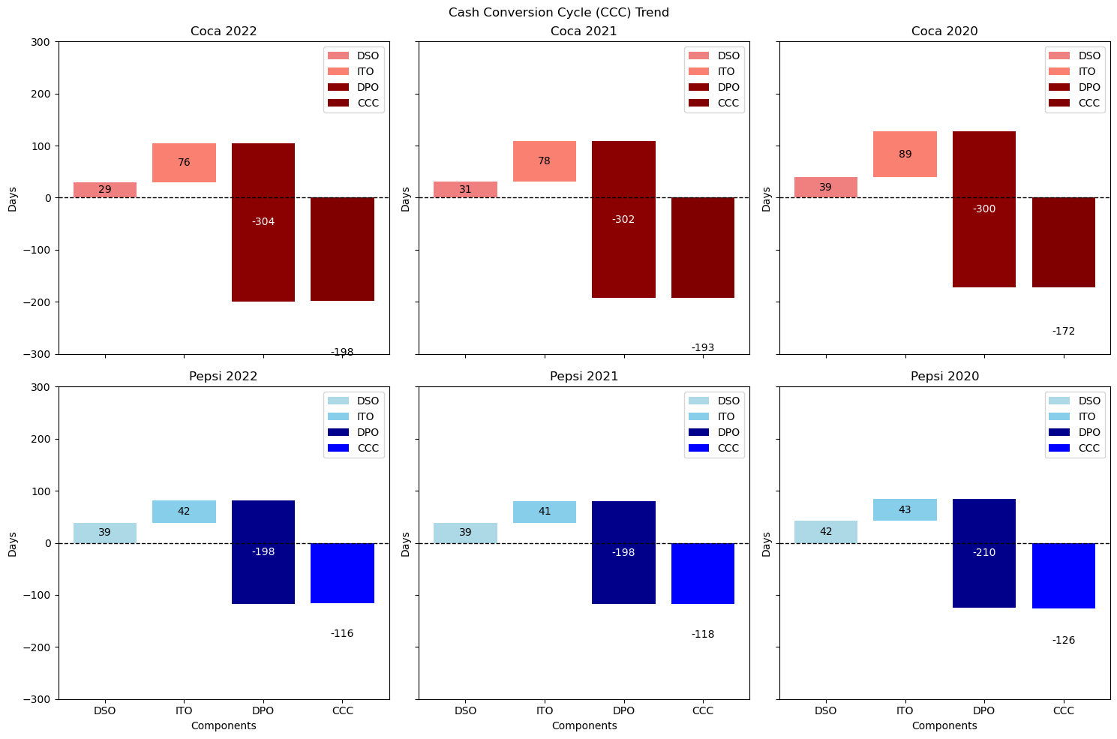
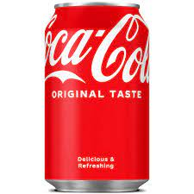
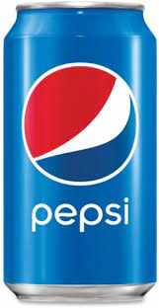
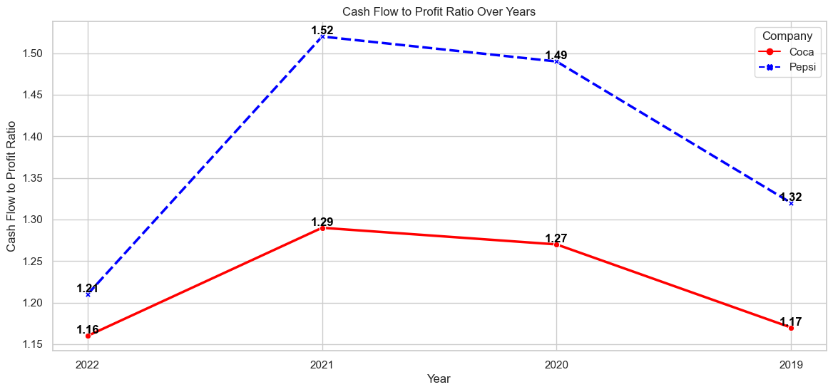
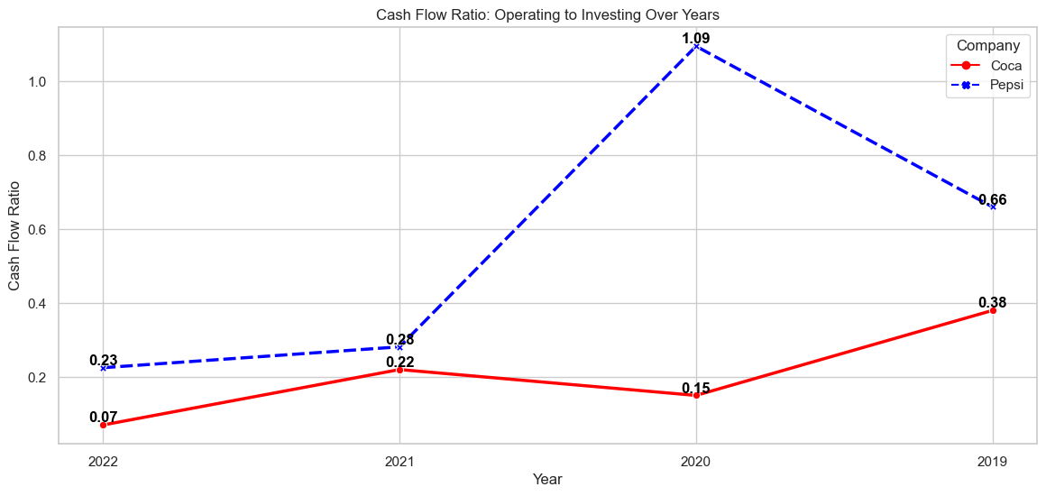
in-depth analysis
Working Capital Strategies:
Super cashflow from operations — 1 dollar earned; 1.2 dollar collected— to support investing (M&A) activities
squeezing distributors
squeezing
themselves
squeezing
suppliers
Operating Cashflow/Net income
Investing Cashflow/Operating Cashflow *-1
15
1.0

Slide 16
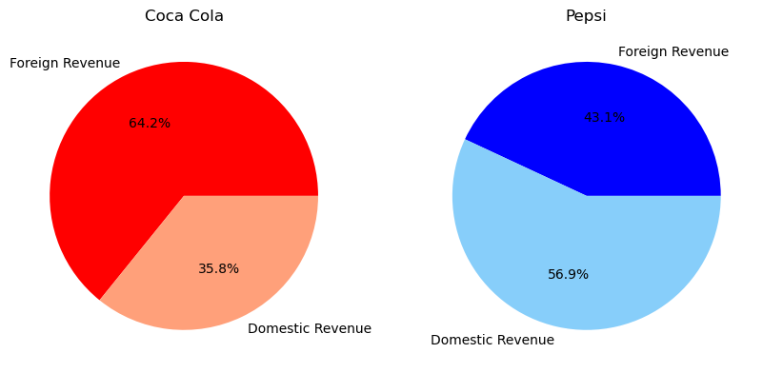
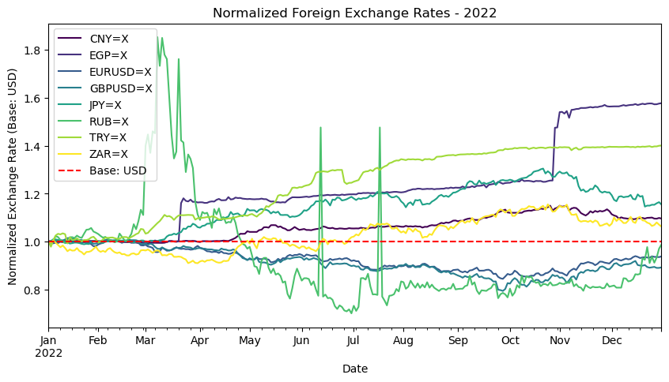
in-depth analysis
Hedging for B.S. optimization: Mitigating Foreign Exchange Fluctuations
Plotting the proportion of foreign sales achieved by both parties
3 measures to shield foreign exchange risks
1st measure: What do you have in your mind?
64,2 %
43,1 %
2nd measure: The natural hedging by the bucket of foreign currency portfolios
3rd measure: Forward contracts, Collars, Swaps etc.
USD STRENGTHENS:
decline in PV of Foreign cash inflows; offset by derivative FV gain
USD WEAKENS:
increase in PV of Foreign cash inflows: offset by derivative FV loss
Example
（1）Coca-Cola US purchased inventory from a Germany company for EUR1,000.
Payment period = 6 months
（2）Purchase date (Mar 1) spot rate @ EUR/USD =1
（3）Interim Report (Jun 30) sport rate @EUR/USD =1.1
（4）Payment date (Sep1) spot rate@ EUR/USD=1.2
Coca-Cola has a forward contract entered into a forward contract to buy EUR1,000 @ EUR/USD=1.05 on Sep 1. This contract would eliminate the cashflow variability effectively.
Under Fair Value Hedge:
(2) Dr. Inventory USD 1000; Cr. Accounts Payable USD 1000
(3) Dr. Foreign Exchange Loss USD 100; Accounts Payable USD 100
Dr. Forward Contract USD 50; Cr. Forward Contract Gain USD 50
(4) Dr. Foreign Exchange Loss USD 100
Accounts Payable USD 1100
Cr. Cash USD 1200
Dr. Forward Contract USD 100; Cr. Forward Contract Gain USD 100
Natural Forex Loss EUR/USD 1-1.2 brought loss of USD 200
Forward Contract EUR/USD 1.05-1.2 brought gain of USD 150
35,8 %
56, 9 %
Plotting the fluctuation of mentioned foreign currencies
16

Slide 17
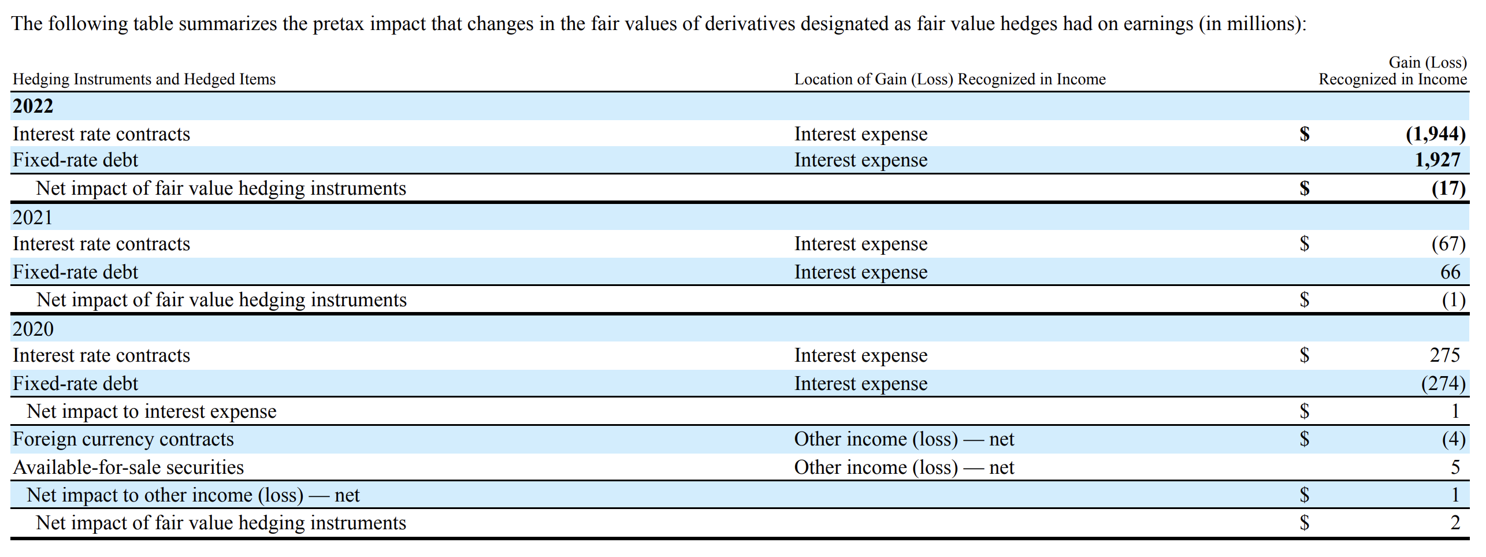
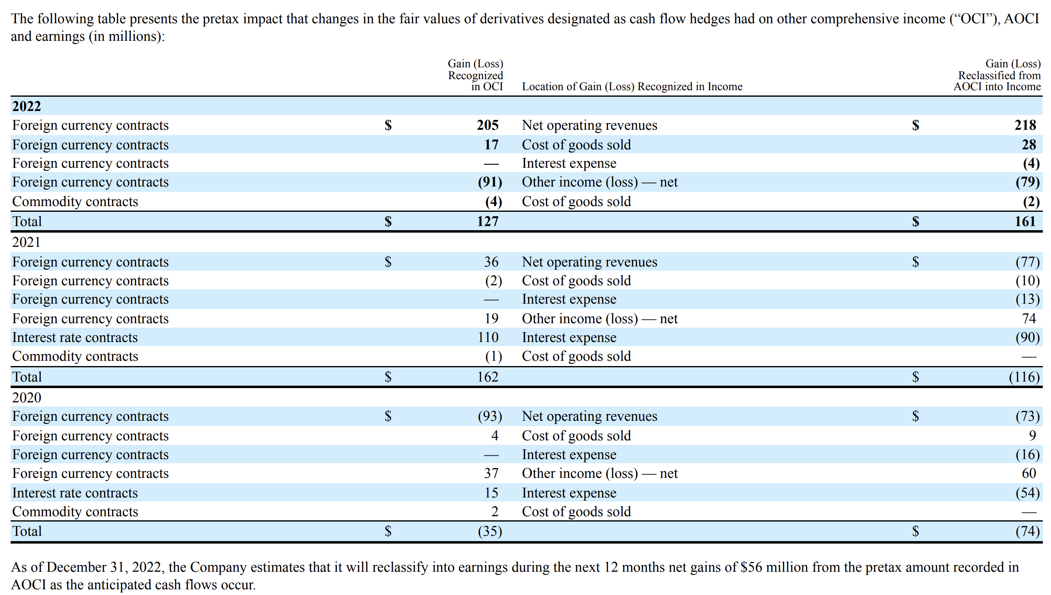
in-depth analysis
Hedging for B.S. optimization: Derivative Financial Instruments for hedging interest risks and commodity price risks
Fair Value Hedge designated by Coca 2022
Interest SWAP contracts
eg. Coca-Cola issued corporate bond with floating interest but is concerned about potential fluctuations in future market interest rates, which could lead to uncertainty in debt costs. To manage this risk, Coca-Cola enters into an interest rate swap transaction with a financial institution.
Coca-Cola agrees to pay a fixed interest rate to theFI
FI agrees to pay Coca-Cola a floating interest rate based on market rates.
Intrest rates are SWAPed. When interest rate rises (over the fixed rate), Coca-Cola recognises a gain and vice versa.
Cashflow Hedge designated by Coca 2022
Commodity Future contracts
Price Lock-In:
PepsiCo wants to lock the price of a significant amount of corn syrup in the next six months.
The current market price for corn futures contracts is $3.50 per bushel,
totaling 100,000 bushels.
After 6 months, the market price of corn is $4 per bushel. PepsiCo can just close out its future contracts and gains $0.5 per bushel and still pays $4 to purchase corns. But eventually the net cost of the purchase is still $3.5 per bushel.
17

Slide 18
in-depth analysis
Goodwill & Trademarks/Patent/other Intangible assets with indefinite lives
Not in the mainstream metrics, but calls for discretion
ASC 350 "Intangibles—Goodwill and Other"
Goodwill is the excess of the cost of an acquired entity as of the acquisition date over the fair value of its identifiable net assets.
In plain words: the residue of Purchase Price after deducting Net Assets of the bought company (shares).
ASC 350 "Intangibles—Goodwill and Other"
Trademarks, trade names, and similar items represent legal rights that are intangible and are often separable. They arise from contractual or legal rights, regardless of whether those rights are transferable or separable from other rights and obligations. (Investment, Capitalized Expense, Divestment and Impairments)
WHY
1. Both: Indefinite useful life, excempted from amortization but subjected to impairments. Amortization: usually straight-line, predictable and regular; Impairments: highly dependent on management’s judgement, accounting policy and evaluation models--difficult to find market equivalents for fair value tests
2. Industry: High frequency of M&A of brands; Dominance power of Trademarks; Substantial proportion/influence on B.S., I.S. etc
3. PepsiCo&Coca-Cola: In their very own financial report, they have highlighted it a major risk for being potentially challenged of the fairity of impairments.
more than 1/3
of total assets
18

Slide 19
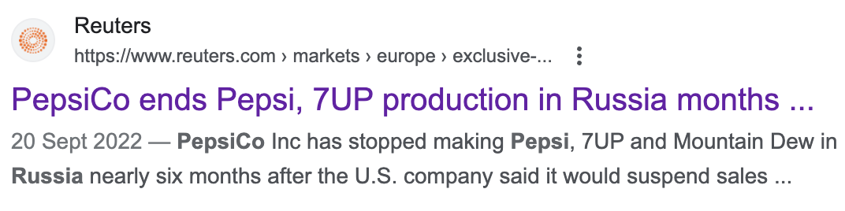
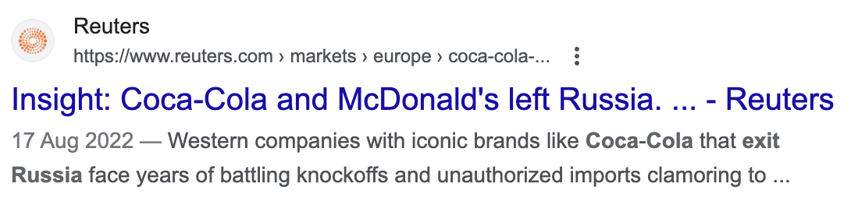
in-depth analysis
Goodwill & Trademarks/Patent/other Intangible assets with indefinite lives
Potential Accounting Pitfalls “encouraged” by accounting standards
Inappropriate capitalization of marketing expenses
Impairments are sensitive to subjectivity-Prone discounted cashflow models
US GAAP Provides Leeway for Capitalizing Advertising Expenses,
While IFRS Generally Restricts Such Practices
US GAAP prohibits impairment reversal, which could discourage the mgmt from recognition at all (IRS not deductible unless cease to operate); IFRS allows reversal to a limited extend
2 way: event triggering; periodical test of impairment (susceptible)
event:
impairment tests:
Coca-Cola in 2022 10-K:
“The performance of recoverability and impairment tests of current and noncurrent assets involves critical accounting estimates. These estimates require significant management judgment, include inherent uncertainties and are often interdependent; therefore, they do not change in isolation. ”
US GAAP
Certain direct response advertising costs are eligible for capitalization if, among other requirements, probable future economic benefits exist. (subject to impairment considerations).
Allows for deferal of prepaid costs
IFRS
Costs of advertising are expensed as incurred. The guidance does not provide for deferrals until the first time the advertising takes place, nor is there an exception related to the capitalization of direct response advertising costs or programs.
PepsiCo: announced impairment loss for Trademarks
Coca-Cola: no impairments
“although we do not anticipate that...will have a material impact on our results of operations...could increase risk of...”
Dr. Trademarks 10
Cr. Cash/Accounts Payable 10
Dr. Impairment loss 2
Cr. Trademarks 2
Periodical Expense: 2
Dr. Advertising Expenses 10
Cr. Cash/Accounts Payable 10
Periodical Expense: 10
19

Slide 20
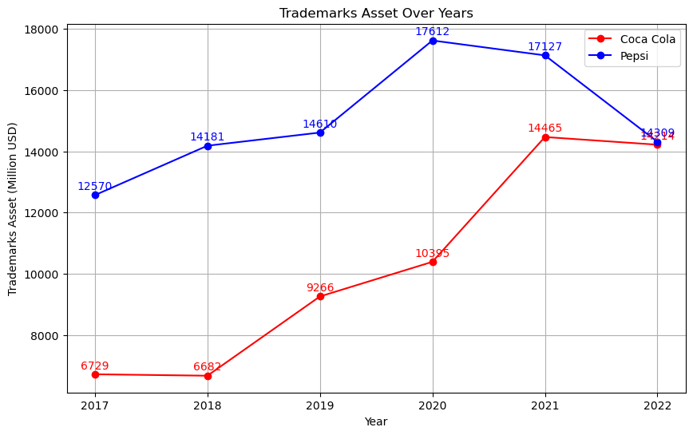
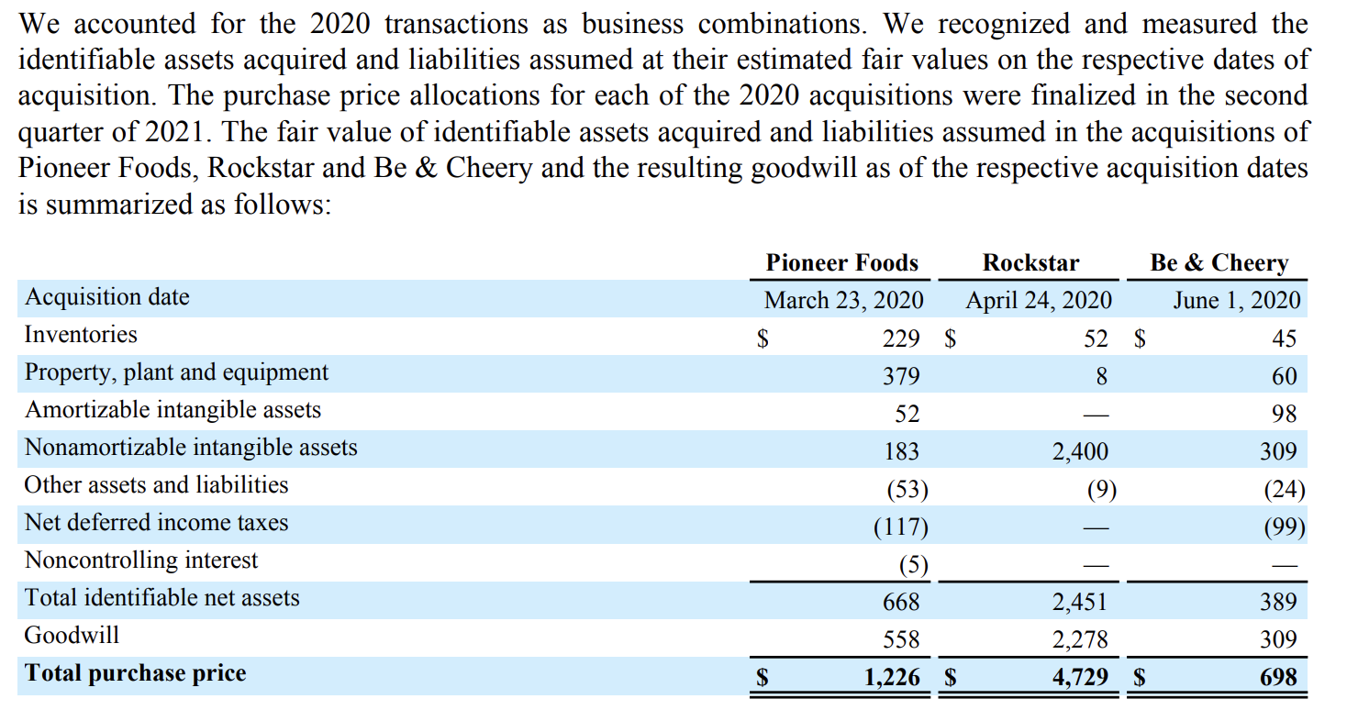
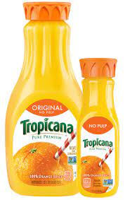
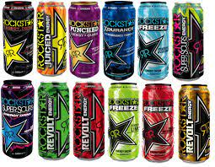
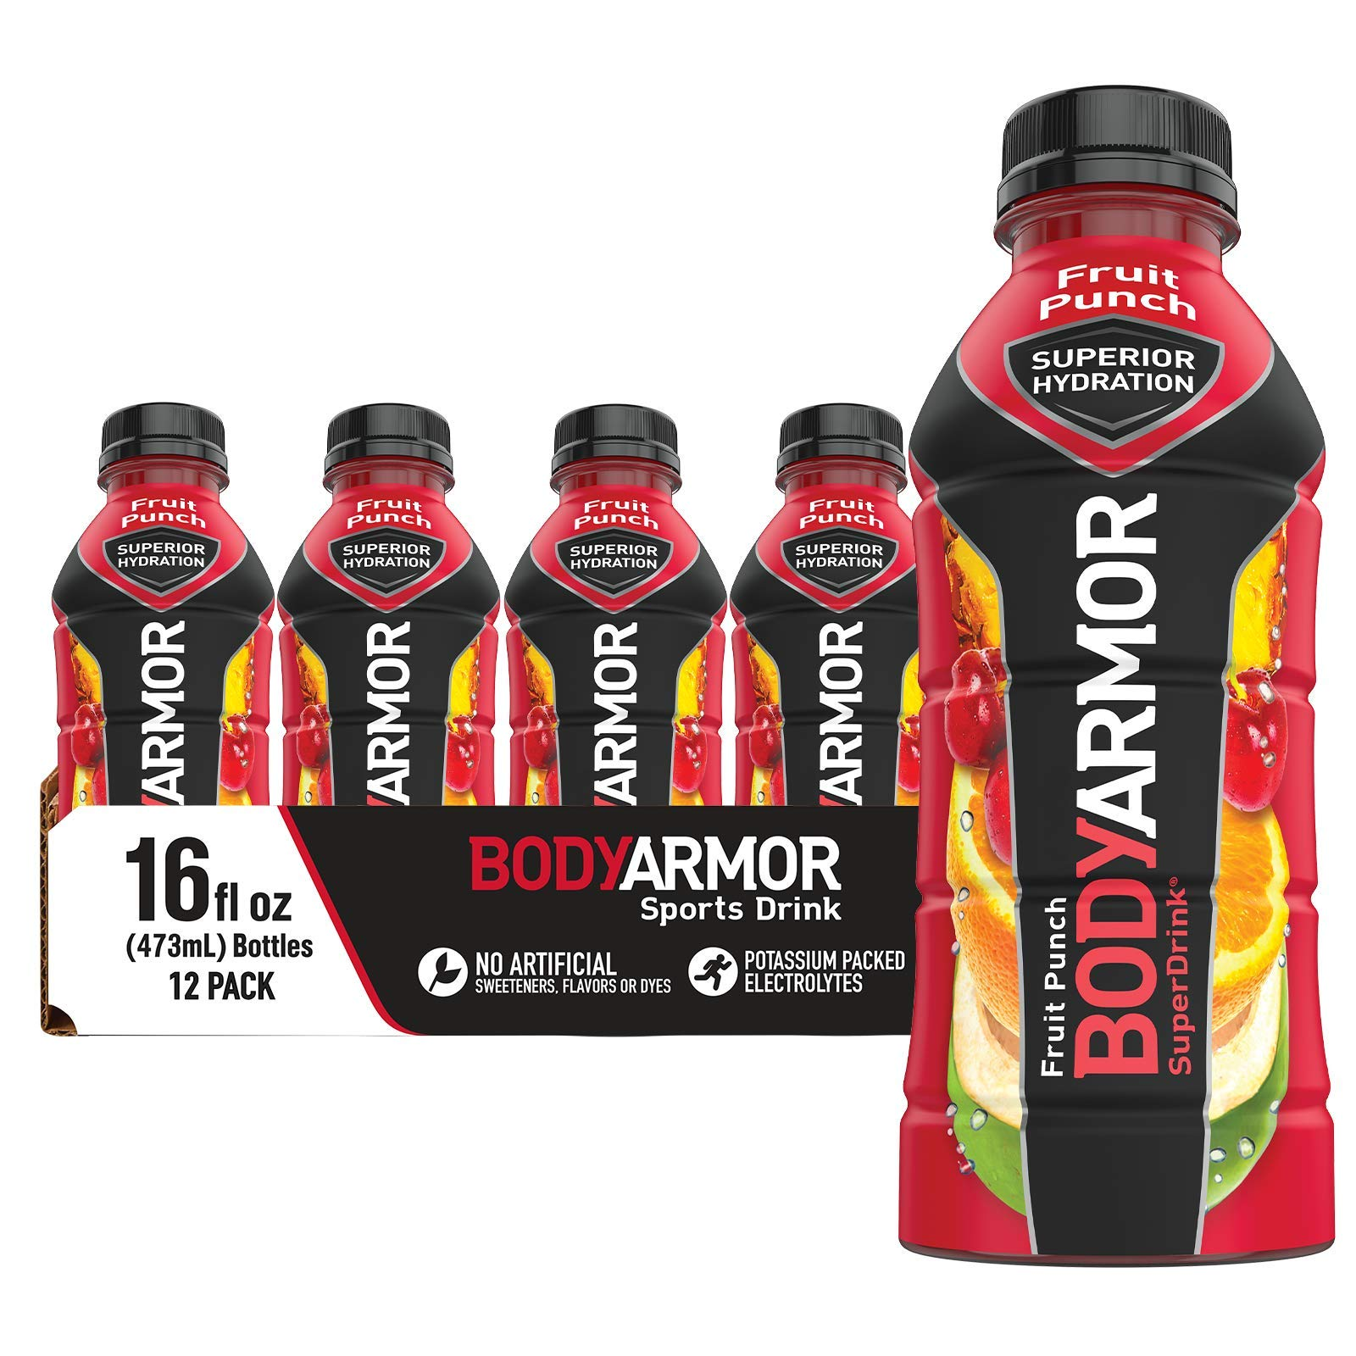
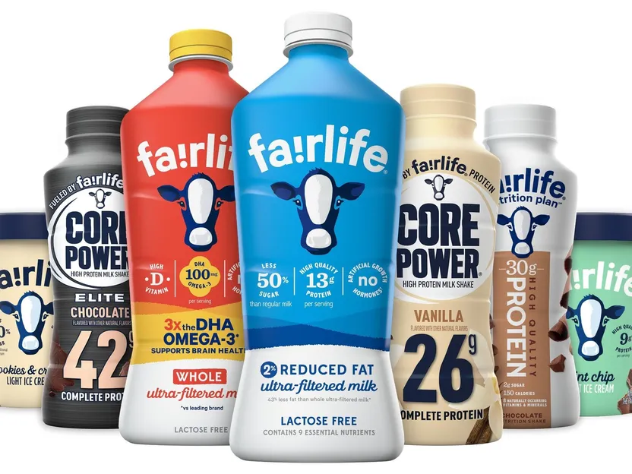
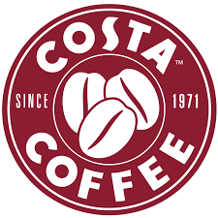
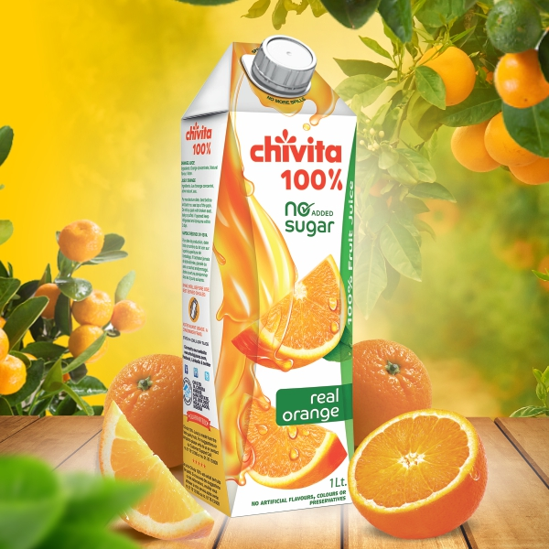
in-depth analysis
Goodwill & Trademarks/Patent/other Intangible assets with indefinite lives
Limited transparency and financial reporting annotations hinder investors' comprehension of the multibillion-dollar value flows.（PepsiCo has better disclosure)
PepsiCo: (1) (2)
better documented measurement of
Trademarks (10-K 503p in total)
in 2020 $3B was added to Trademarks
due to M&A events of the following:
4.7b purchase of Rockstar of which 2.4b is paid for Trademarks and 2.3b goes to Goodwill;
1.2b purchase of Pioneer Foods of which 0.2b is paid for Trademarks and 0.6b goes to Goodwill; and 0.3b is paid for the Trademarks of Be&Cherry in another 0.7b aquisition
in 2022 $3B was taken away from Trademarks due to the business restructuring by devesting Tropicana. And the influence was also well documented.
Coca-Cola: (3)
lack of explanation in the 183 pages 10-K;
numbers missing or hardly adding up
in 2021 BodyArmor:
85% of BodyArmor with proceedings of $5.6b, 4.2b for the Trademarks and 2.2b for Goodwill
in 2020 and 2021 fairlife:
Total 2B for fairlife,
1.3b goes to Trademark and 0.8b for Goodwill
in 2019
Total 5.5B for purchasing Costa, CHI etc.
No more information was further given.
The documentation is much less transparent compared to
The impairment loss was also not explained as clearly as PepsiCo.
1
2
3
20

Slide 21
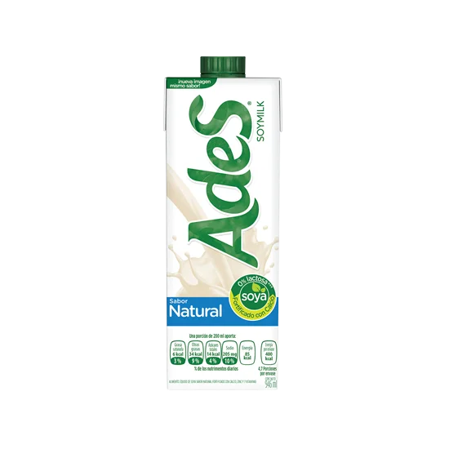
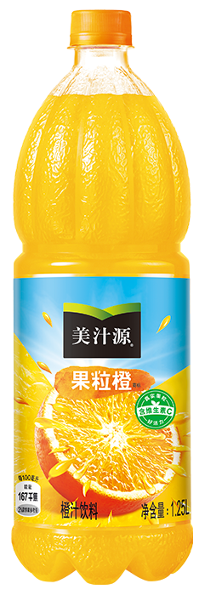
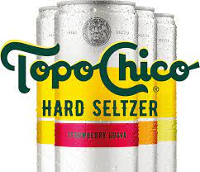
in-depth analysis
Goodwill & Trademarks/Patent/other Intangible assets with indefinite lives
Critical thinking on Goodwill+Trademarks
Coca-Cola as example (the dual is in same situation):
From 2016 to 2022,
The total assets grew from $87.3b to $92.7b (CAGR 1.7%). However the Total non-current assets to Total assets grew from 61% to 76% (15pct total growth), which implies a significant shift of assets holding strategy, also resulted from the frequent M&A deals (competition) over the 6 years.
The companies that Coca purchased are all in beverage industry and fabless (outsourced the production part and only held some working capital and Trademarks when merged). The premium that Coca (or PepsiCo) was willing to pay was for the Trademarks.
Therefore, the increased Goodwill (+8billion) and Trademarks (+8billion) should be collectively considered as Coca-Cola's overall valuation of the acquired trademark.
Bear in mind that the carrying value of Coca-Cola and other sub-brands were only 6billion in 2016 to begin with. And in the past few years the purchased brands gave rise to 16 billion of Trademark-related assets.
The 16 billion trademarks came from less reputated brands such as chivita, COSTA, fairlife, BodyArmour, these new brand transactions result in a disproportionately significant increase in brand assets compared to the existing trademark value. Lack of the disclosure of the evaluation of new coming brands that represent large proportion of total assets hinders investors to understand the true value of these deals.
CAGR
1.7%
+16billion
6billion

Slide 22
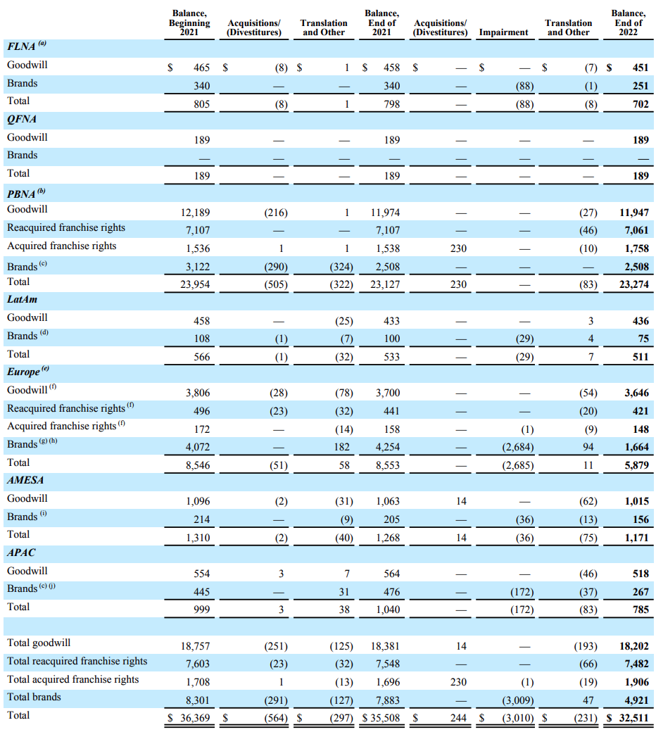
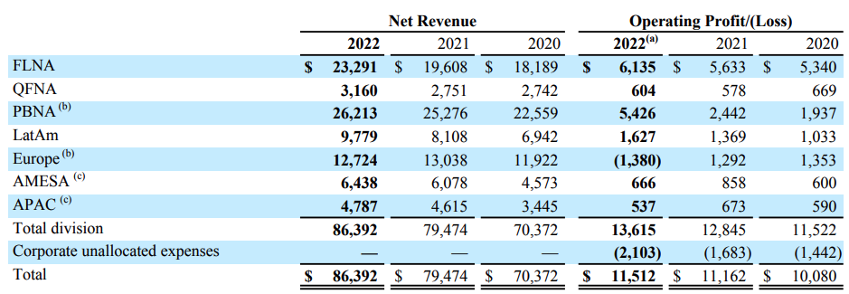
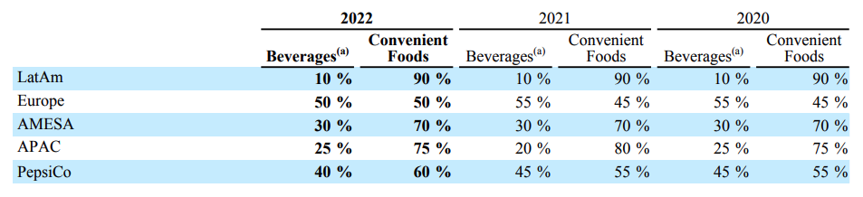
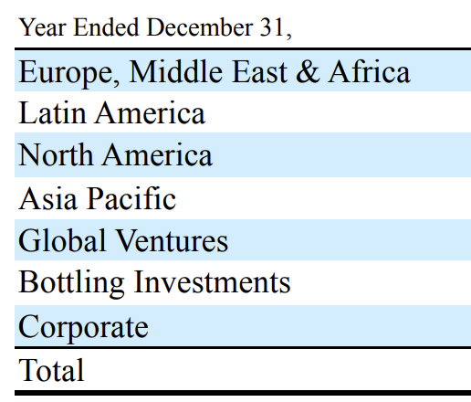
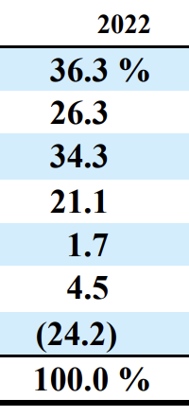
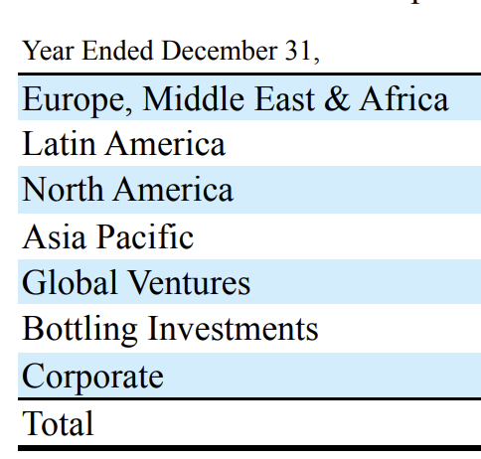
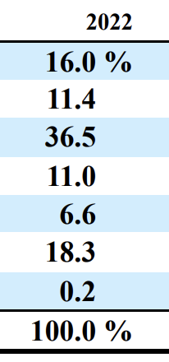
in-depth analysis
Business Division Operating Reports:
Based on the disclosure of financial closure, PepsiCo appears to have a more advanced managerial/statutory reporting system
PepsiCo is able to record their revenue/cost/expense by Product by Trademark by Geography internally. PepsiCo shows significant strength in reporting system.
From managerial/statutory reporting perspective, they must have sorted out all granular/dimensional relations for every single data entry.
Revenue Recognition
Costing
Expense Center Alloc.
Balance Sheet by Divison
Numbers add up perfectly, there’s no residual. Revenue is pivoted freely per BU per GEO.
eg. QFNA: North America Quaker Foods; Europe (can be further split)
Margin calculation shows strong stationarity, and this empowers operational improvement based on horizontal comparison
Full capacity to generate income statement per BU per GEO, and if necessary, per Productline.
PepsiCo managed to measure tricky assets such as Goodwill/Trademarks to BU/GEO level
Numbers struggling to add up
Much overlap is shown
Could feul internal friction
Margin disperses irregularly.
Much limited and less powerful reference for the management
A global Share-Based Compensation allocation system enables expense to be allocated to all divisions
No disclosure
Unknown
No disclosure
Unknown
22

Slide 23
Conclusion
23

Slide 24
Key Insights
Conclusion
Results:
Engine handels any public companies ticker from yfinance – comparison of any two companies you are interested in and see financial ratios in a matter of milliseconds
Financial ratios only become meaningful with an in-depth understanding of the business model
Total Assets size is equal for both companies
Profitability is almost equal (same business model)
Outlook:
Qualtitative research remains just as important → An LLM dashboard feature could support in information/text retrieval

Slide 25

THANKS FOR YOUR ATTENTION
25

Slide 26
Links
Links
Project GitHub Repo (Code Base)
PepsiCo Brand Portfolio (Image)
PepsiCo Form 10-K
Coca-Cola Brand Portfolio (Image)
Coca-Cola Form 10-K
yFinance (Data)
Streamlit (Apps/Dashboard)
Plotly (Graphing Library for Python)
Coca-Cola Bottling Business Model
Statista (Brand Value)
26

